Slide 1
Hyperspectral Imagery Classifier{
Object-Oriented Programming
Final Project
[Using Machine Learning Algorithms]
Group 7 Member List
電機碩一 110318087 李芮翰
電機碩一 110318094 梁仔弘
電機碩一 110318167 尚衍容
}
Group 7

Slide 2
Table Of ‘Contents’ {
01
02
03
Object-Oriented Programming
Final Project
What is Hyperspectral?
< Quickly run over of hyperspectral images >
Main Features
< How to use and how it works >
Workflow of the App
< The structure of the app >
}
Group 7

Slide 3
01 {
[What is Hyperspectral?]
Object-Oriented Programming
Final Project
< Quickly run over of hyperspectral images >
}
Group 7

Slide 4
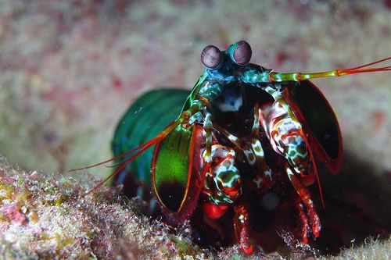

Main ‘Hyperspectral image’ {
Object-Oriented Programming
Final Project
}
Humans can process three channels of colour , while mantis shrimps perceive the world through 12 channels of colour, and can detect UV and polarised light.
Group 7

Slide 5
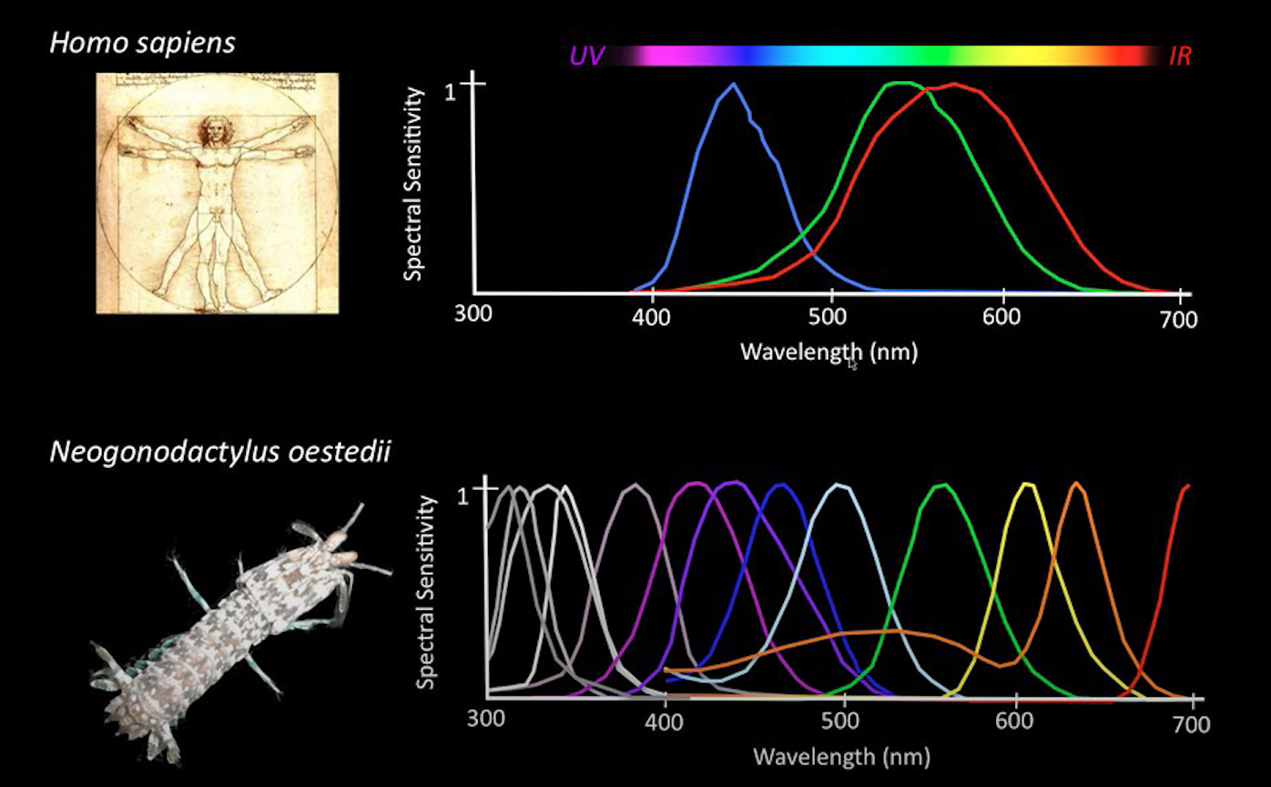
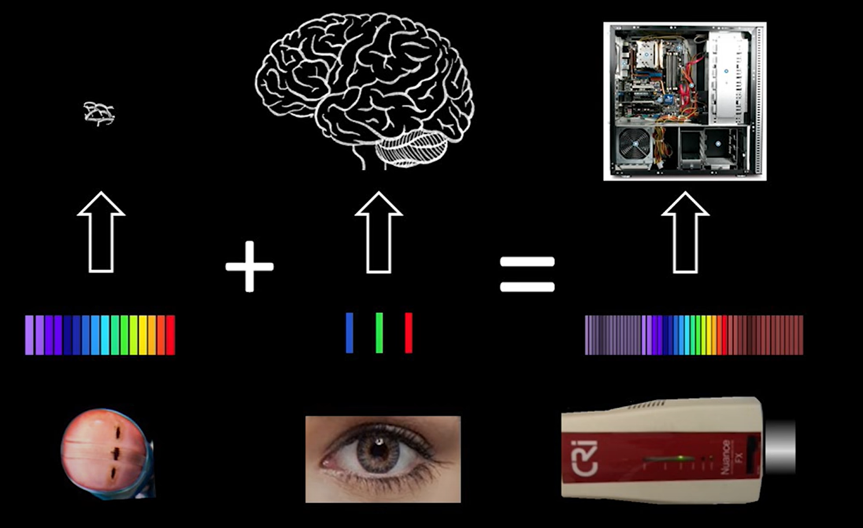
Main ‘Hyperspectral image’ {
Object-Oriented Programming
Final Project
}
Combines the benefit of the mantis shrimp eye and huge processing power of computer to analyzes the spectrum.
Group 7

Slide 6
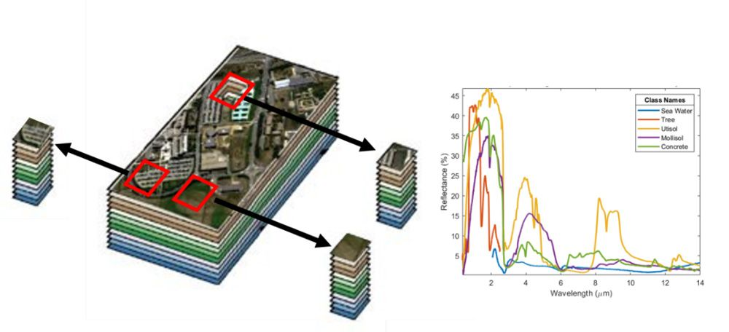
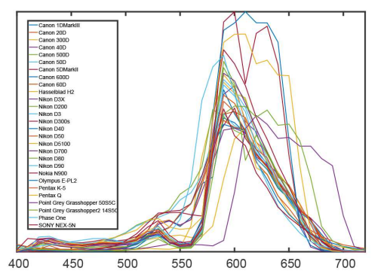
Main ‘Hyperspectral image’ {
Object-Oriented Programming
Final Project
}
Hyperspectral imaging allows us to obtain additional information the human eye cannot see.
Group 7

Slide 7
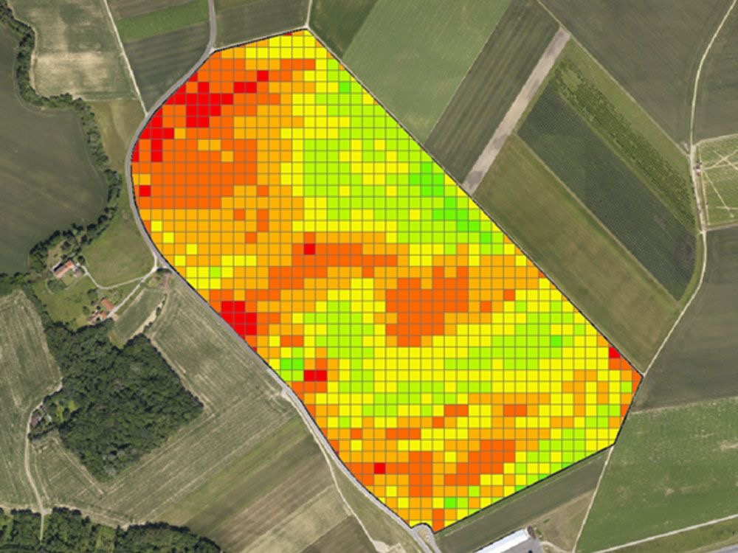
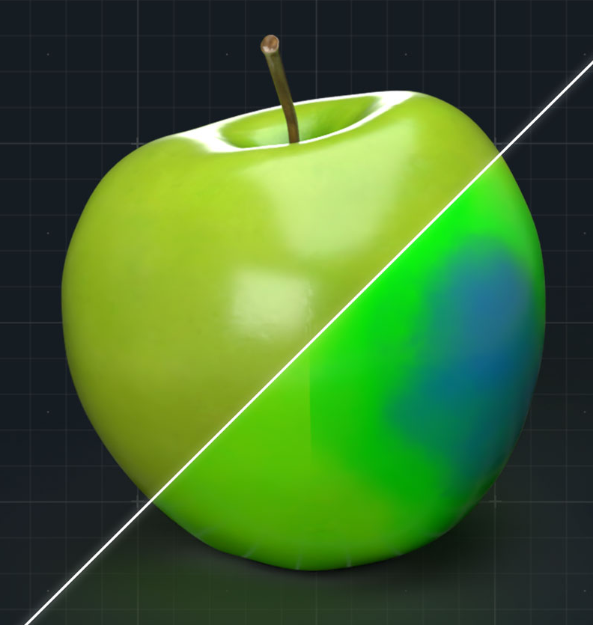
Main ‘Application’ {
Object-Oriented Programming
Final Project
}
Remote sensing, Environmental Monitoring ,Food
Group 7

Slide 8
02 {
[Main Features]
Object-Oriented Programming
Final Project
< How to use and how it works >
}
Group 7
Notes:
介紹主要的功能

Slide 9
Main ‘Goals’ {
Object-Oriented Programming
Final Project
Train a model to classify with ease.
Train a model to perform classification on hyperspectral images.
Visualize classification results.
Visualize model’s performance instead of boring statistics.
}
Group 7
Notes:
兩個功能：輕鬆訓練模型、視覺化結果

Slide 10
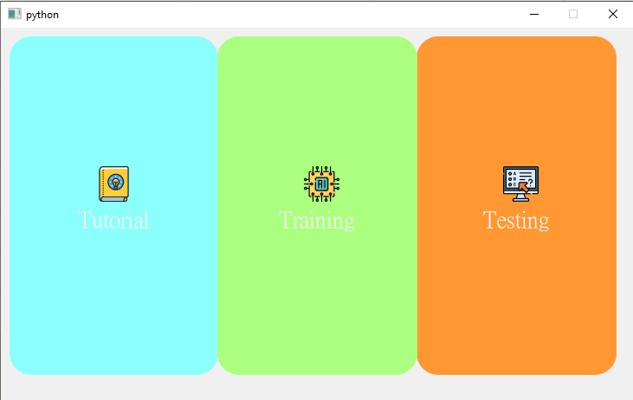
Main ‘Menu’ {
Object-Oriented Programming
Final Project
}
Select the main functions here.
Group 7

Slide 11
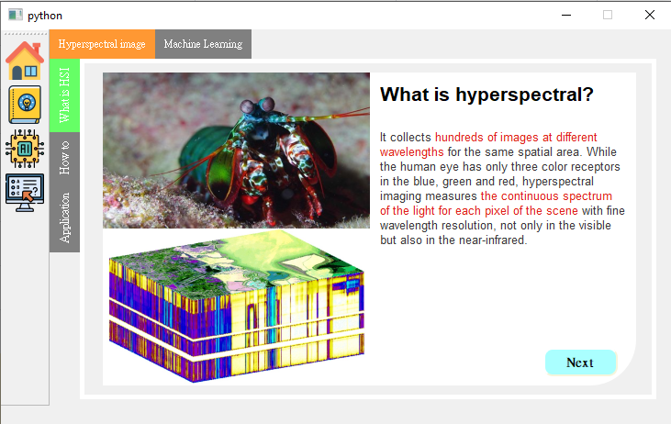
Tutorial {
Object-Oriented Programming
Final Project
}
Understand what is hyperspectral images, and used algorithms here.
Group 7

Slide 12
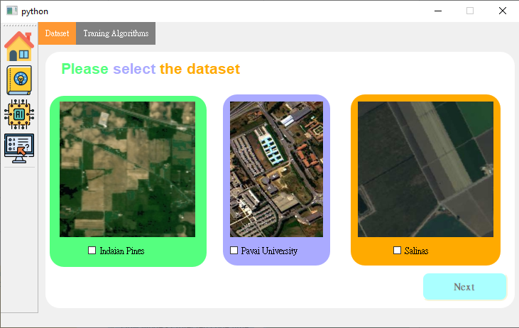
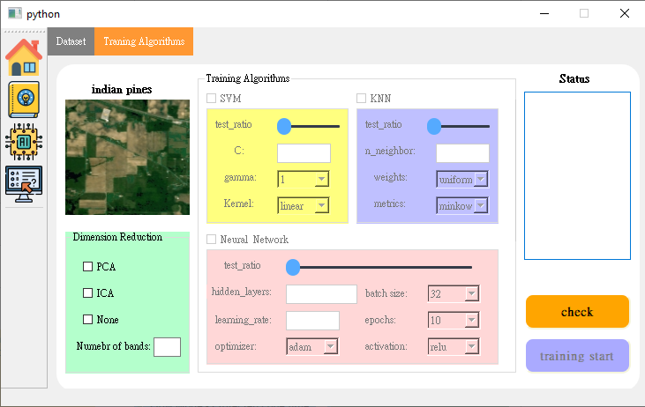
Train {
Object-Oriented Programming
Final Project
}
Select dataset, and hyperparameters for user’s model.
Group 7
Notes:
1:40結束

Slide 13
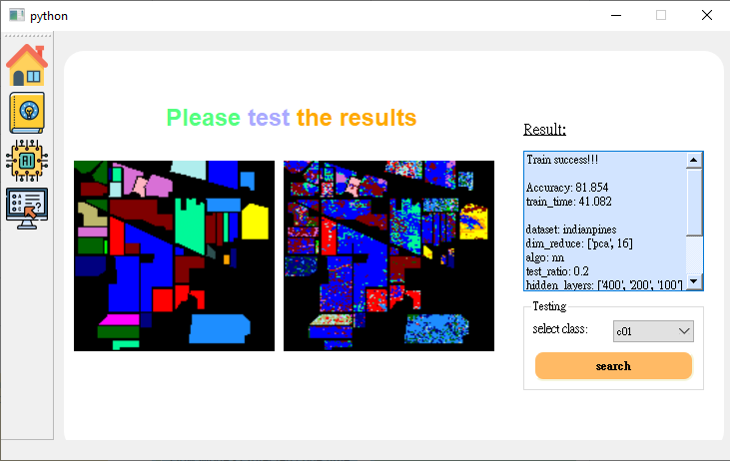
Test {
Object-Oriented Programming
Final Project
}
This is a tab to show results after training (or existed model).
Group 7
Notes:
20秒講完

Slide 14
03 {
[Workflow of the App]
Object-Oriented Programming
Final Project
< The structure of the app >
}
Group 7

Slide 15
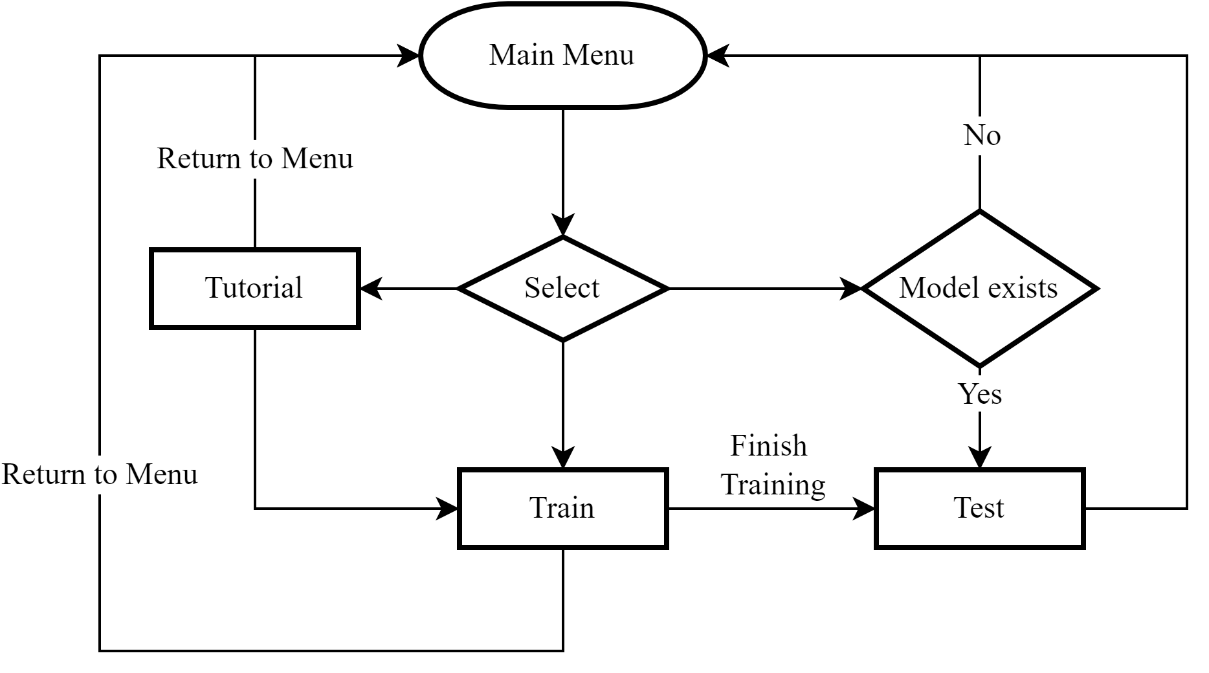
Flowchart of hyperspectral imagery classifier {
Object-Oriented Programming
Final Project
}
Group 7

Slide 16
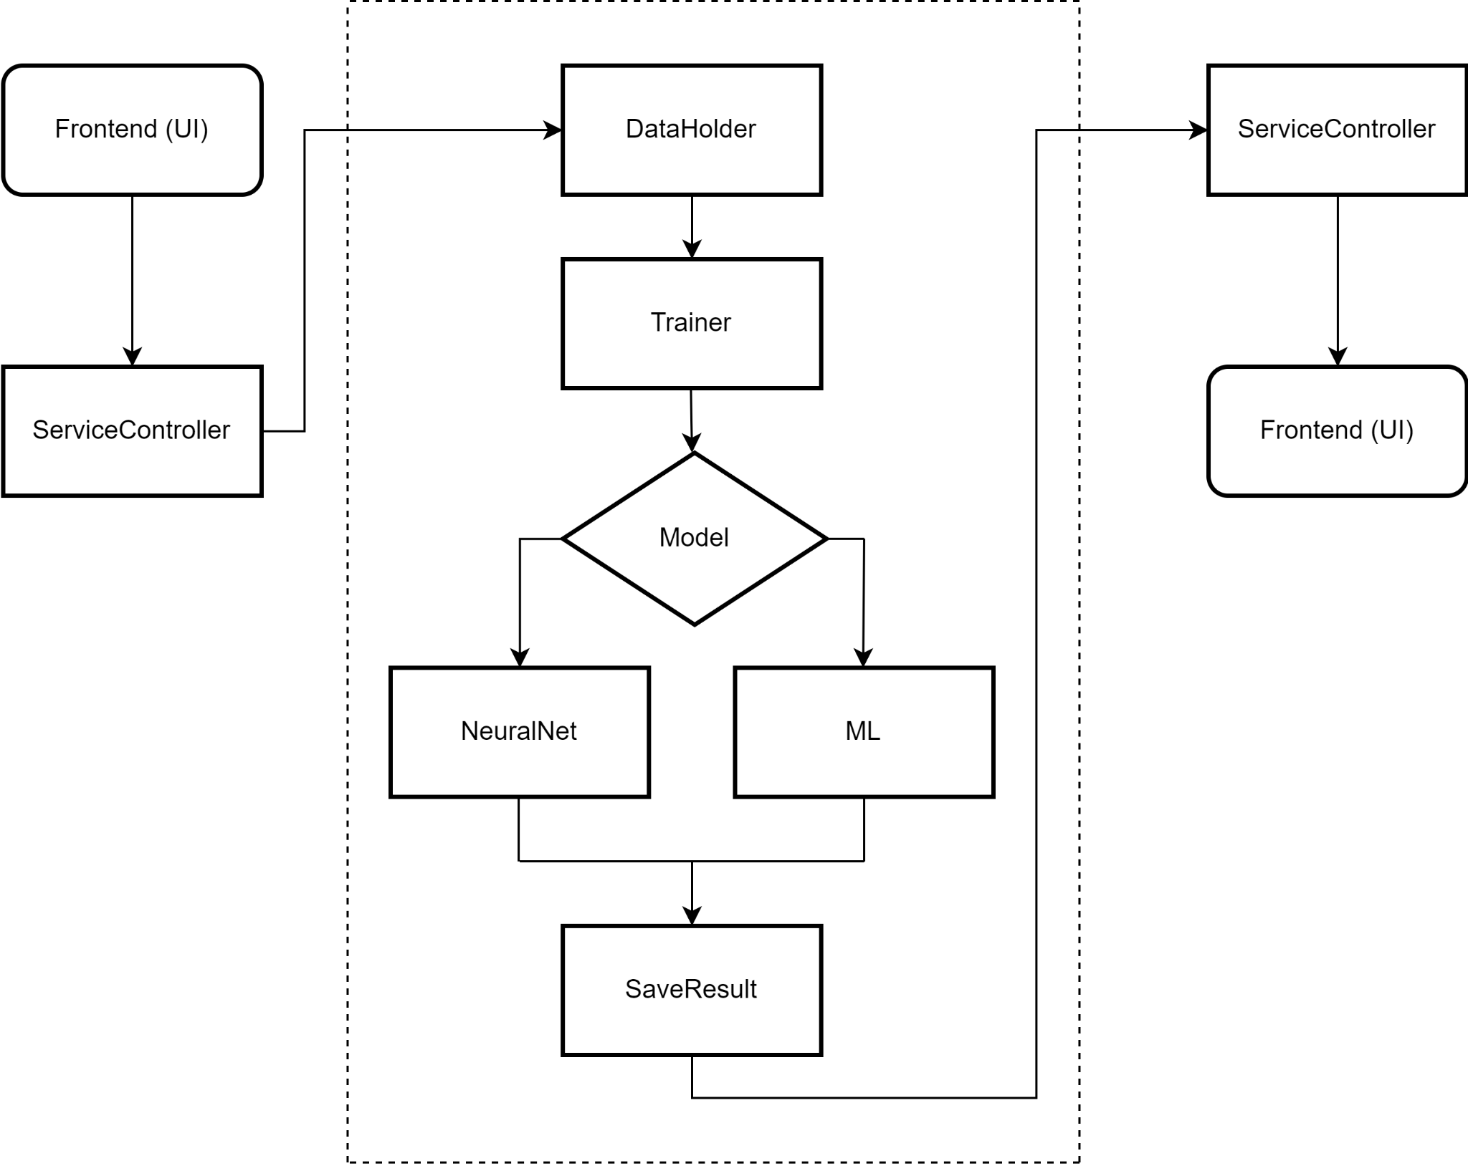
Flowchart of our program architecture {
Object-Oriented Programming
Final Project
}
Group 7

Slide 17
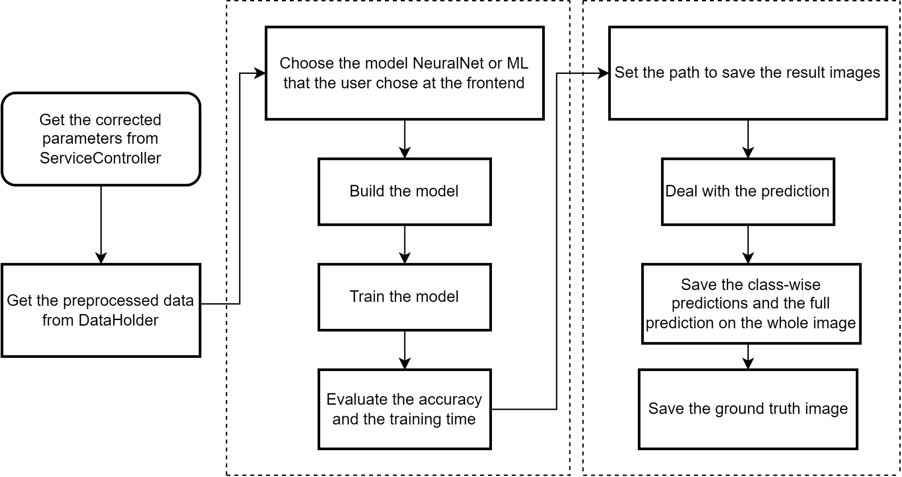
Flowchart of the Trainer {
Object-Oriented Programming
Final Project
}
Group 7

Slide 18
Structure of the data from ‘Frontend’
Object-Oriented Programming
Final Project
client_data={
“dataset”:”indianpines”,
“dim_reduce”:[“pca”,16],
“algo”:”nn”,
“hparams”:{
“test_ratio”:0.2,
“hidden_layers”:[256,128,64],
“batch_size”:32,
“n_epochs”:10,
“optimizer”:”nadam”,
“activation”:”relu”,
“Learning_rate”:0.001
}
}
Group 7

Slide 19
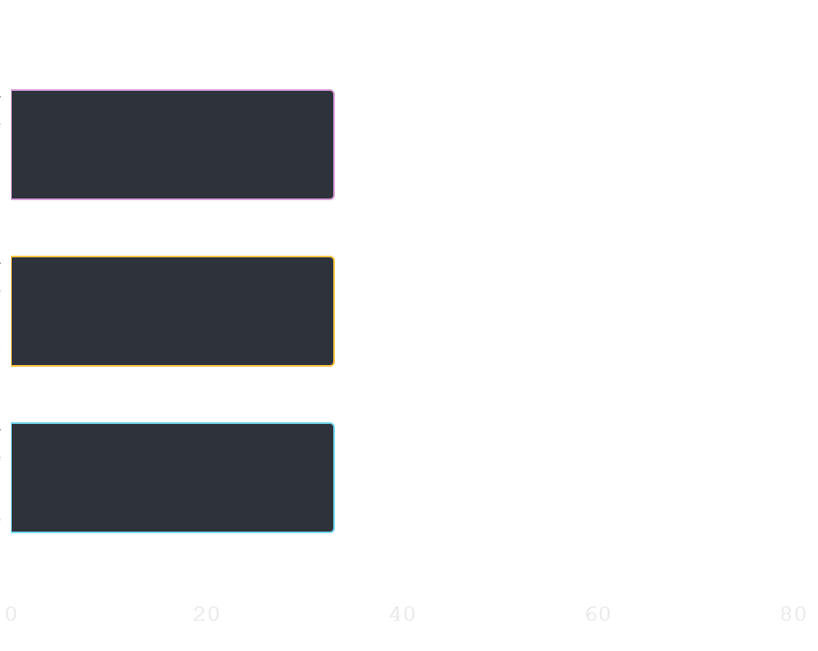
Work ‘Contribution’ {
Object-Oriented Programming
Final Project
33%
電機碩一 110318087 李芮翰
UI Design
33%
電機碩一 110318094 梁仔弘
Neural Network
33%
電機碩一 110318167 尚衍容
SVM, KNN
}
Group 7

